Slide 1
Bioinformatics @ Wistar

Slide 2


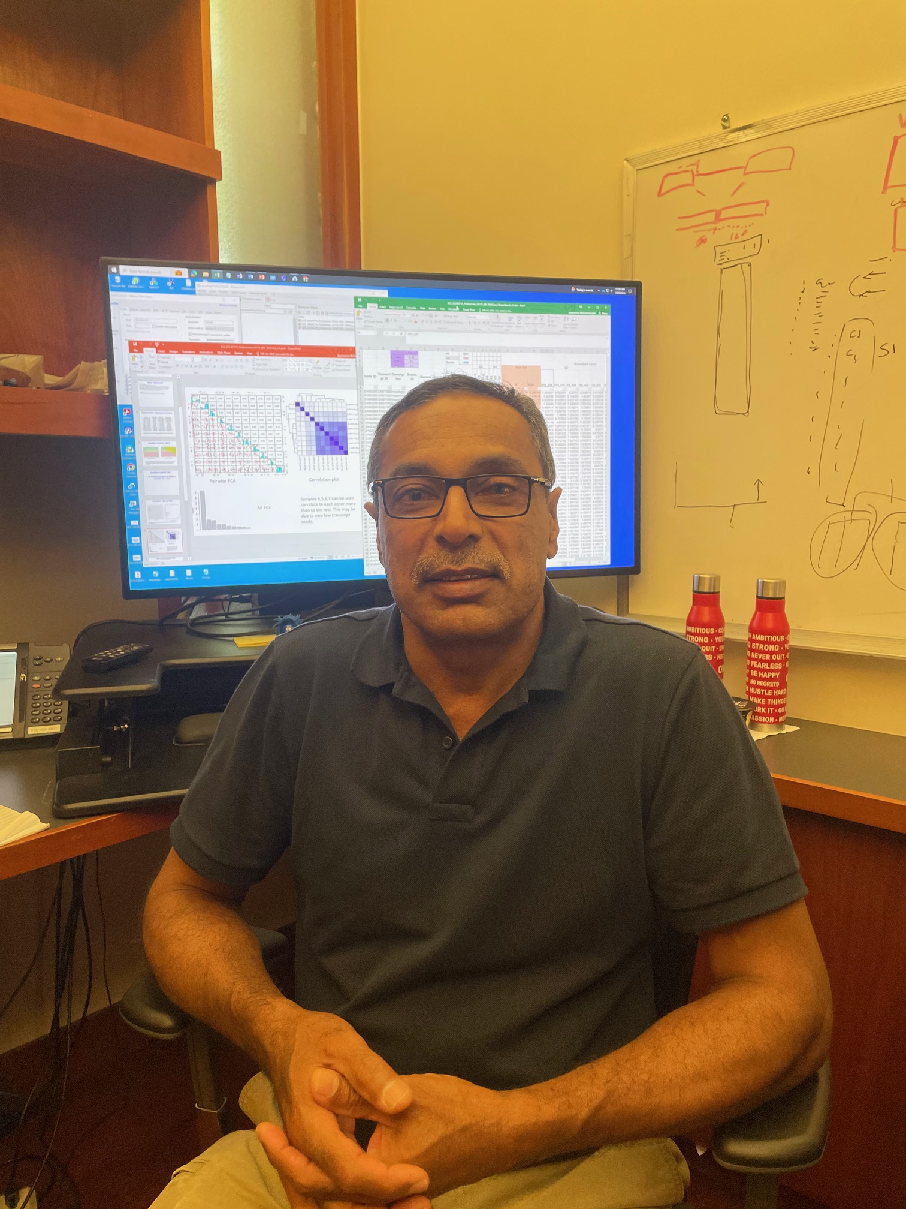
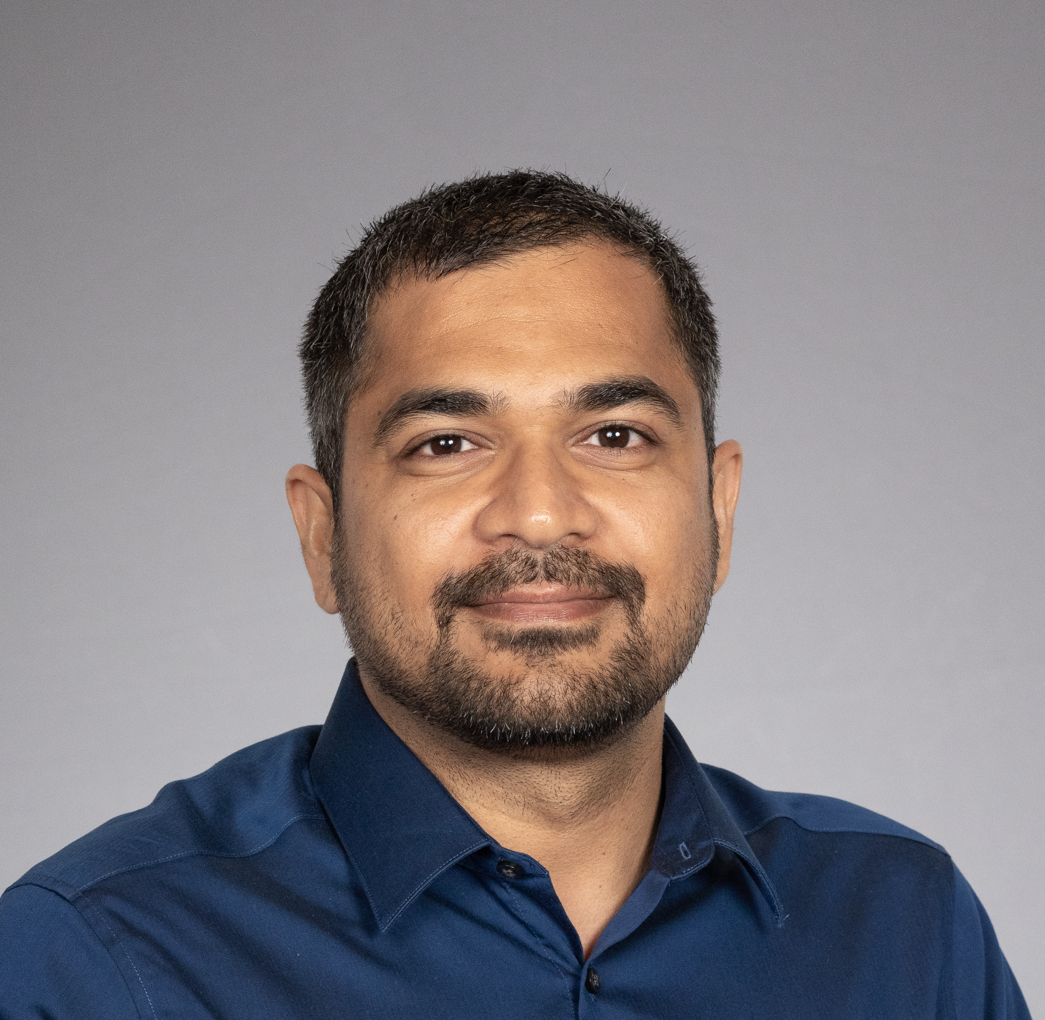

Wistar Institute Bioinformatics Team
Jozef Madzo
Co-director
Andrew Kossenkov Co-director
Jayamanna (Priya) Wickramasinghe (Associate) Managing Director
Bhanu Karisetty Bioinformatic Analyst
Ying (Julia) Ye Bioinformatic Analyst

Slide 3
Bioinformatics pipelines:
Gene Regulation: Transcriptomics / Epigenetics
RNA-seq (expression)
ChIP-seq / CUT&RUN (histone marks / TF)
ATAC-seq (chromatin accessibility)
Hi-C
RRBS, WGB
Single-Cell experiment
scRNA-seq
scATAC-seq
Single nuclei RNA-seq (snucRNA-seq)
Long read sequencing
PacBio HiFi sequencing
ONT
Genomics: Variant detection
Exome sequencing
Low-pass WGS
RNA-editing

Slide 4
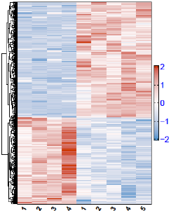
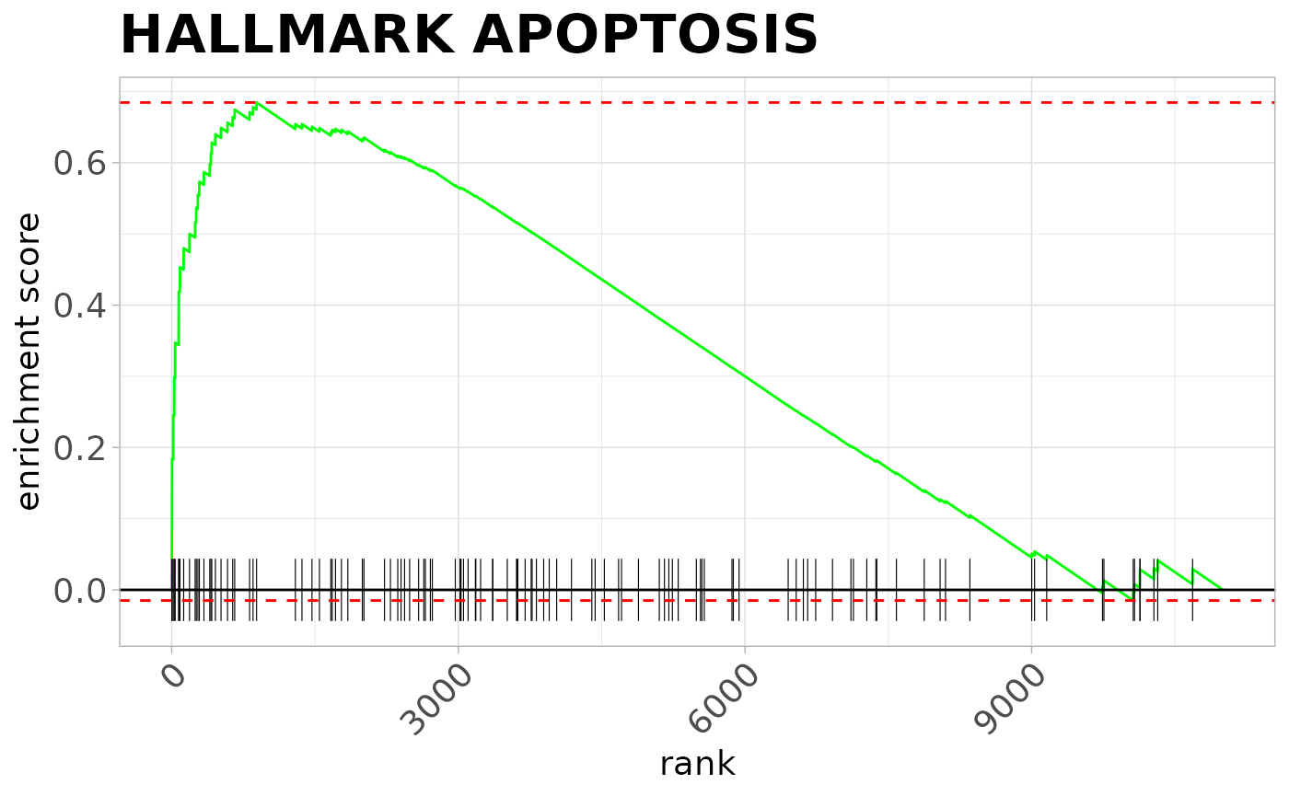
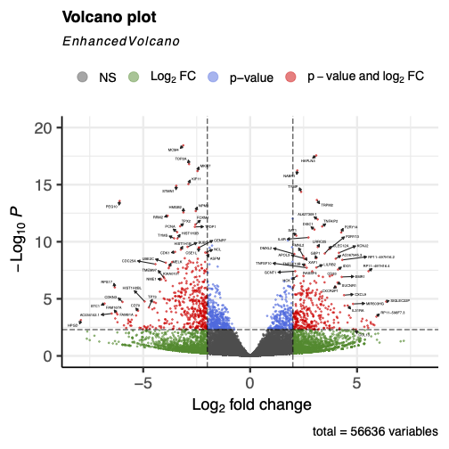
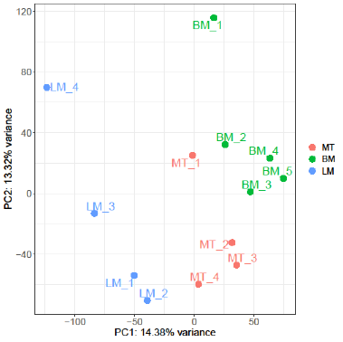
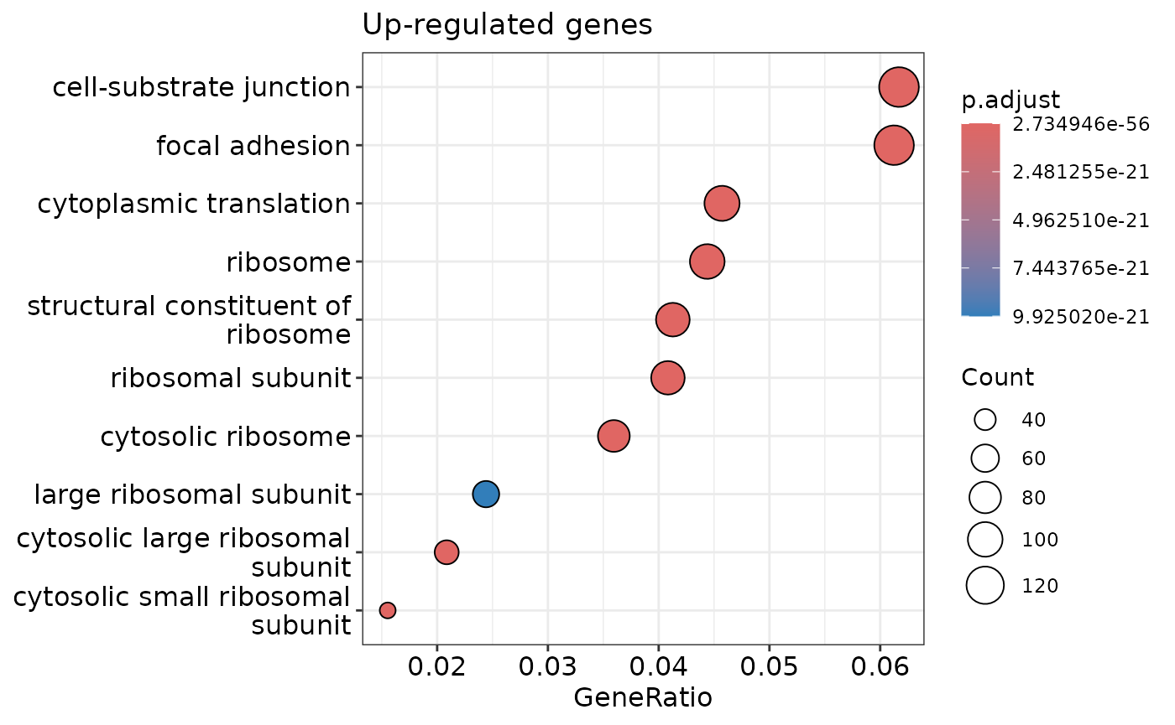
Example of RNA-seq analysis
Volcano plot
Detection of differentially expressed genes between conditions
Heatmap plot
Hierarchical clustering of samples based on gene expression
PCA plot
Visualization of relative differences in samples in reduced dimensions (2D)
Pathway analysis
Looking for a significantly enriched pathway with GSEA and/or Gene Ontology

Slide 5
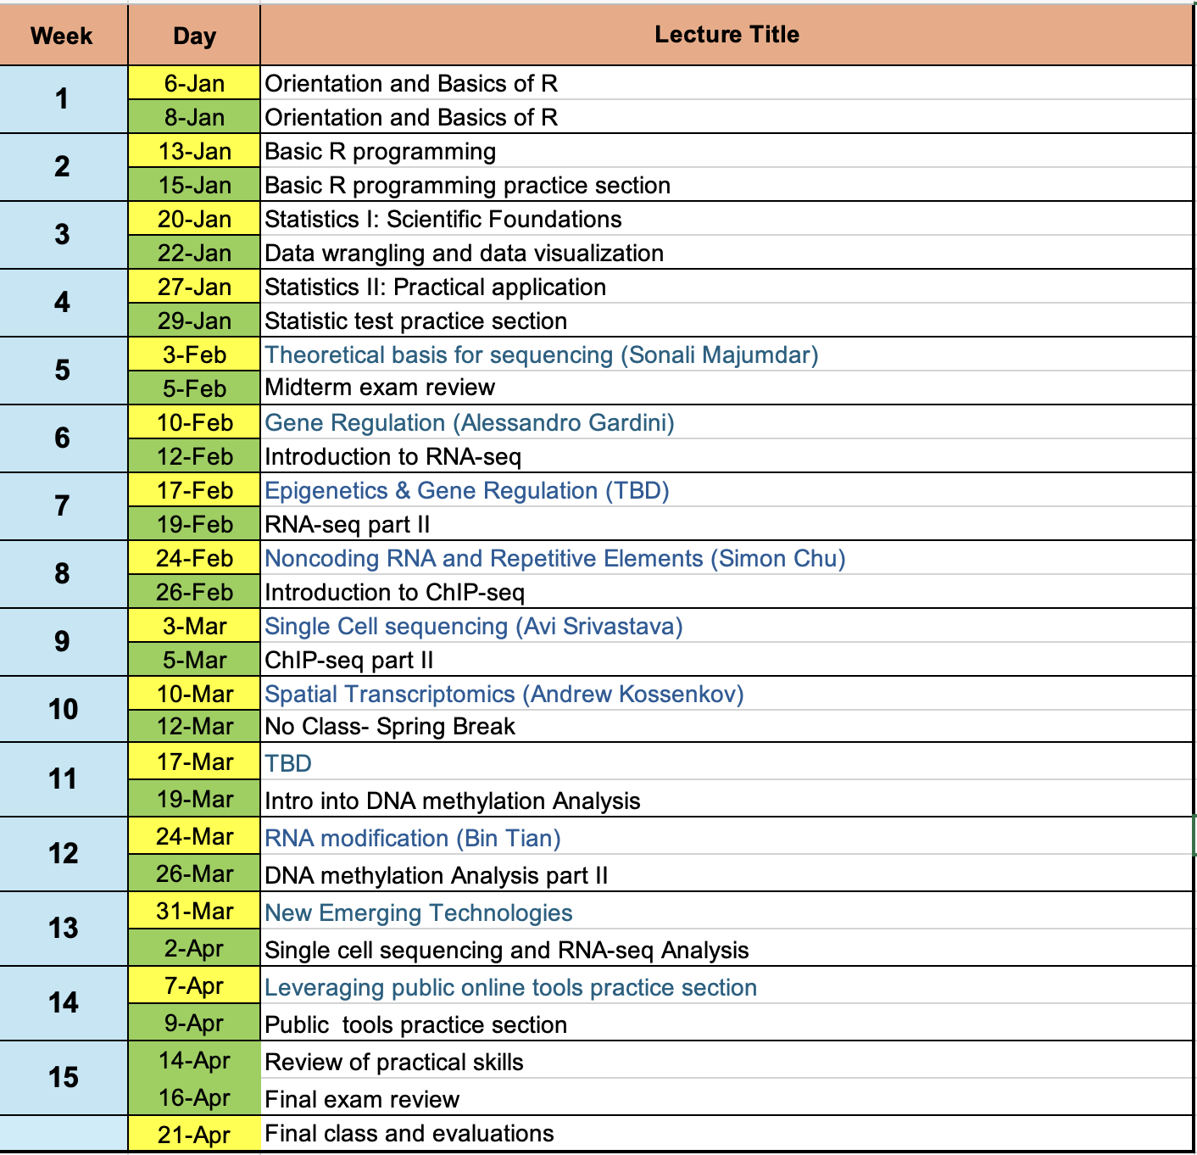
Calendar
Tue – theoretical lecture
Thr – practical / coding exercise

Slide 6
How this is going to work
Objective: learn R / Linux and independent work with RNAseq data
Have to attend the lecture (Thursday practical lecture)
Office hours are Thursday 3.30pm - 4.45pm (Stay on zoom )
Optional if you need help with something; can also get help through email or Slack
If there will be work assigned on Thursday, that will be due next week

Slide 7
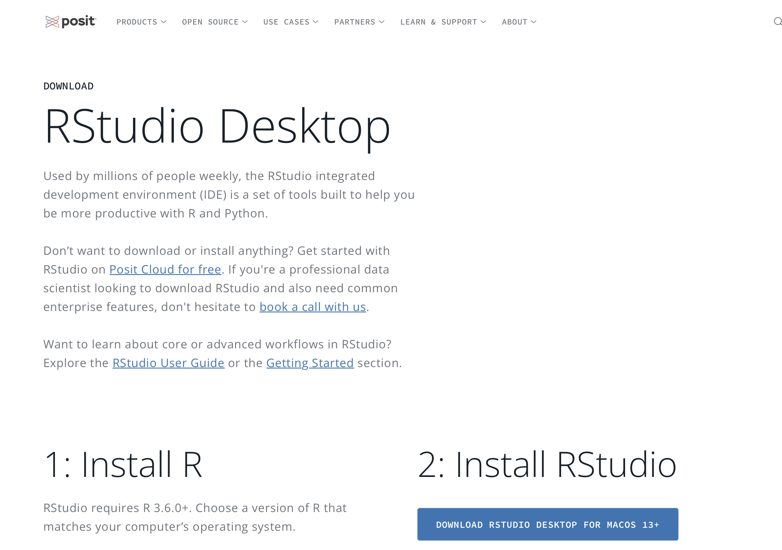
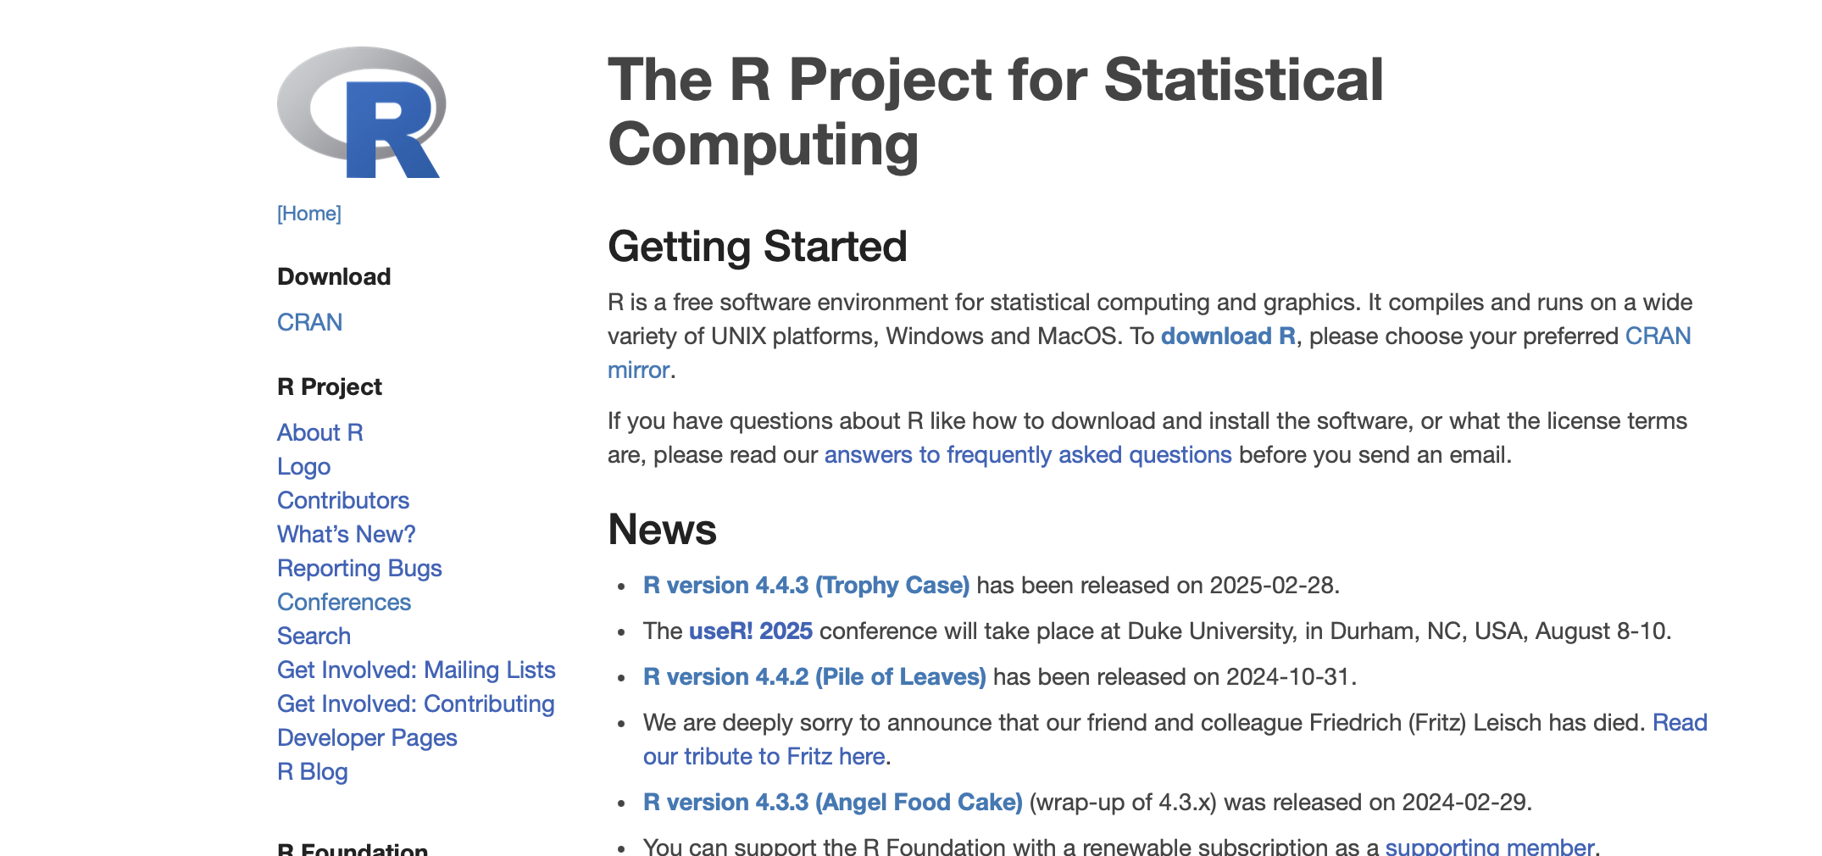
Software
R
RStudio

Slide 8
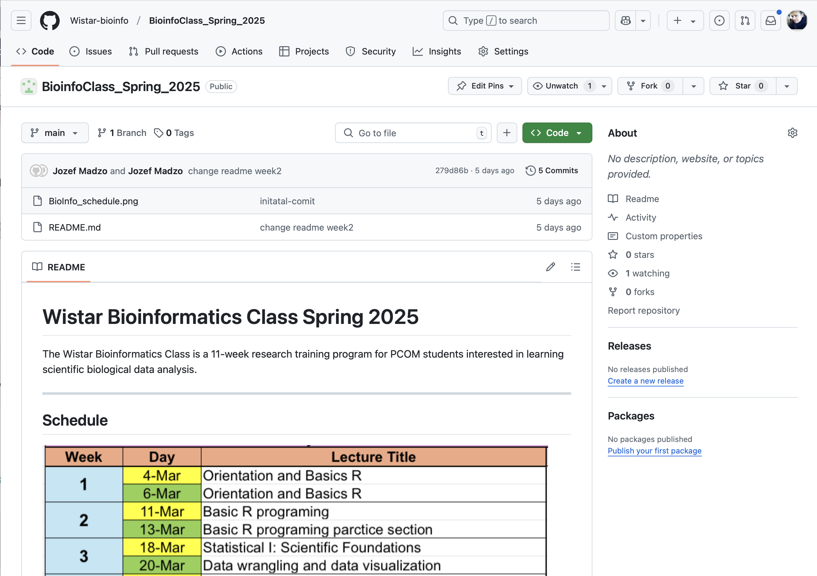
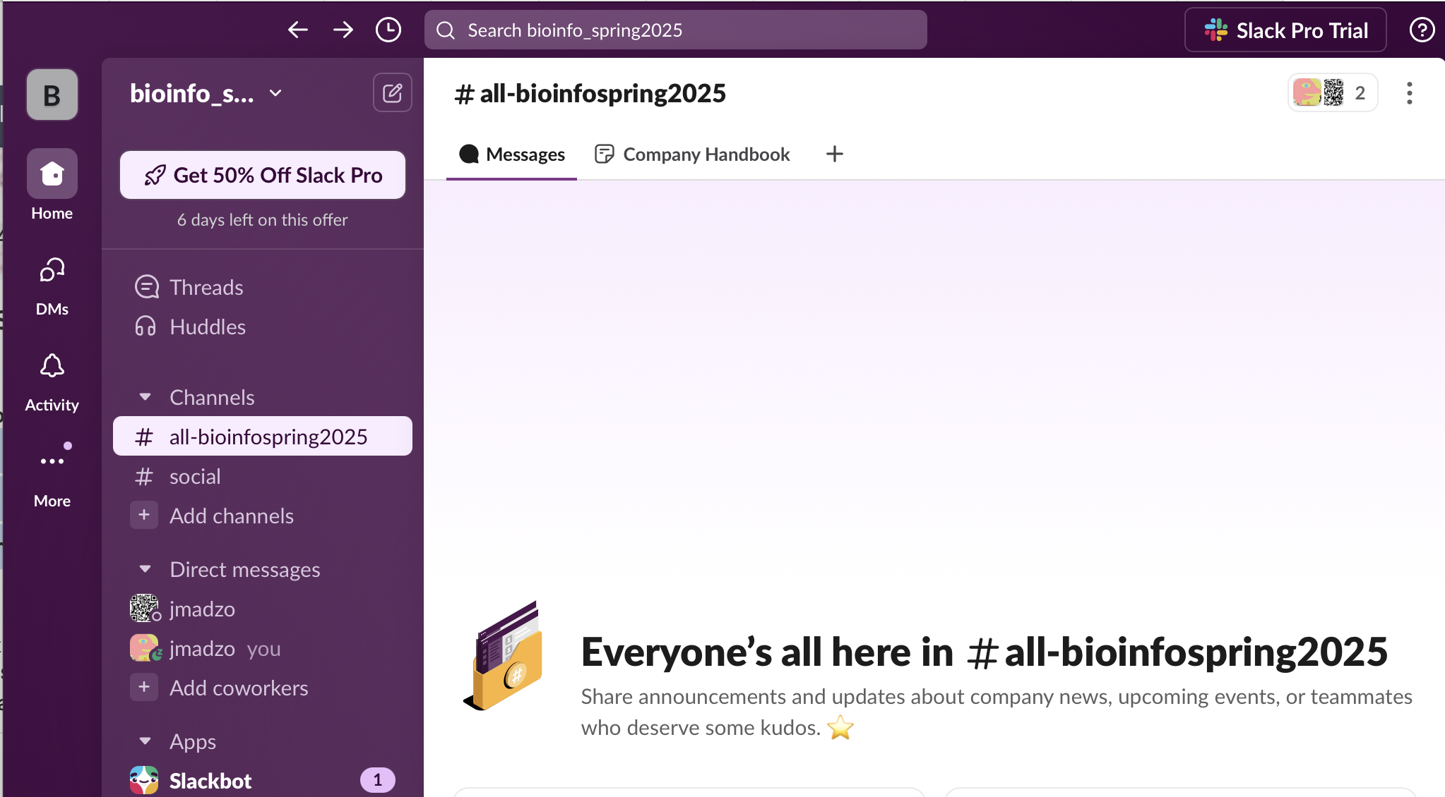
Resources
Github
Slack
https://join.slack.com/t/bioinfospring2025/shared_invite/zt-31aqz3j8g-Ha7eNObbwzGDP1U9Wr7wRg
https://github.com/Wistar-bioinfo/BioinfoClass_Spring_2025
You can also email me at jmadzo@wistar.org

Slide 9
Poll

Slide 10
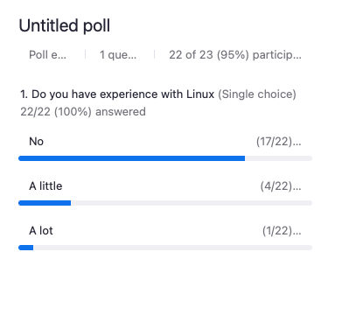
Poll
Do you have experience with Linux?

Slide 11
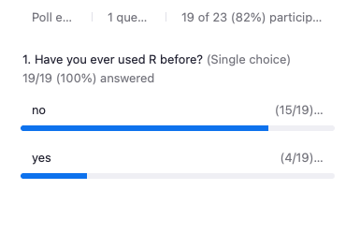
Poll
Do you have experience with R?

Slide 12

R Programming Language
Open-source scripting language developed for statistical analysis
Was originally known as S
S was developed in 1975
S was reimplemented as R in 1993
Heavily used in bioinformatics, with our own archive Bioconductor, for biology-related packages

Slide 13
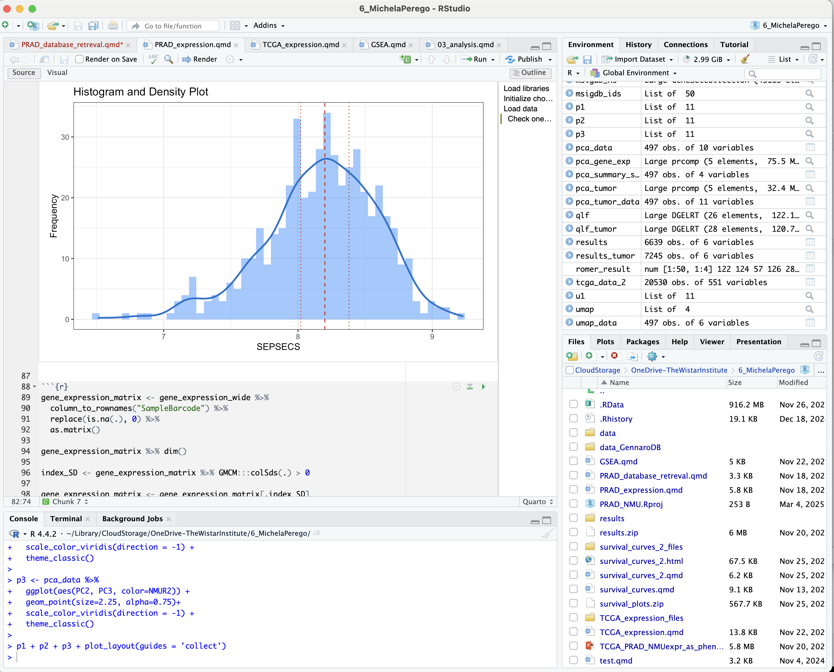

RStudio environment

Slide 14

The Tidyverse and RStudio environment
“The tidyverse is an opinionated collection of R packages designed for data science. All packages share an underlying design philosophy, grammar, and data structures.”
Keep everything simple
Use existing data structures instead of custom, aka, use tidy data
Functions should do one thing well
Glue the simple things together; simple things put together are more powerful than one complex thing
Design for humans

Slide 15
What is markdown (and Rmarkdown)?
Markdown is just text, with a few optional symbols that allows a markdown interpreter to make it look good. Goal is to have something that still is human readable even without the interpreter.
Rmarkdown is markdown for R
All the features of markdown, with extras
Intention is to make documenting data analysis easy
Execute code in Rmarkdown files (cannot do this in markdown)
Can also knit Rmarkdown files into other files
html, pdf, or Microsoft word reports
Can make websites and slides with Rmarkdown

Slide 16
Why use markdown and Rmarkdown?
Bioinformatics is mostly on a Linux machine using the command line terminal. The rest of the universe uses Macs or PCs.
This causes a bunch of problems
operating systems don’t talk to each other easily
files are in proprietary formats (no Microsoft anything on Linux)
files are not readable in plain text (and terminal needs them to be!)
Markdown solves all the problems
Simple
readable by every machine in both GUI and terminal AND humans
allows some simple formatting to increase human readability

Slide 17
Demo

Slide 18
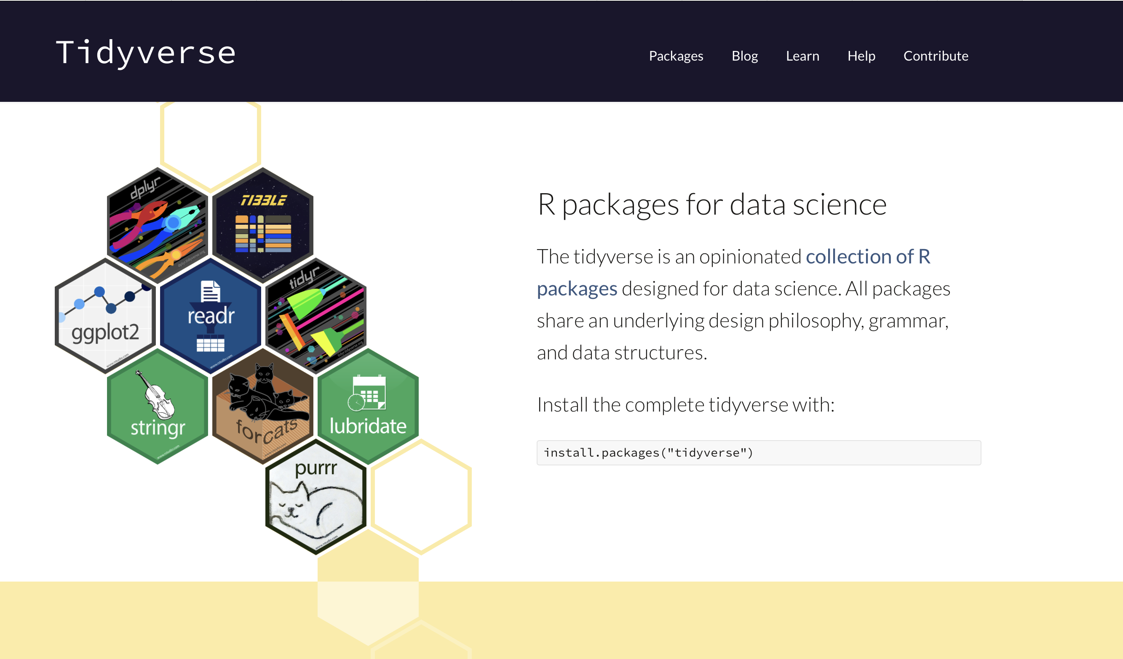
Demo Introduction to Data Wrangling with dplyr

Slide 19
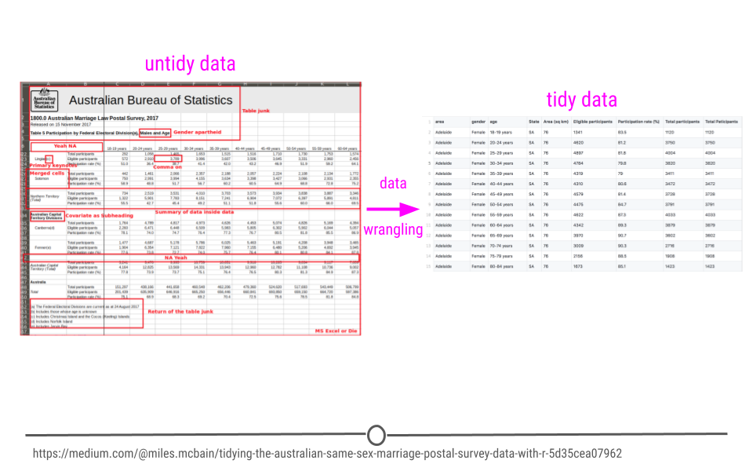
Tidy Data
https://jhudatascience.org/tidyversecourse/wrangle-data.html

Slide 20

Tidy Data
Each variable is in a column.
Each observation is a row.
Each value is a cell.

Slide 21
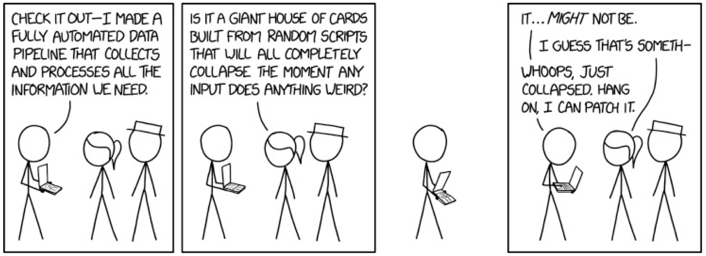
Data Wrangling
data wrangling – organizing your data into the form you want
• Everyone spends most of their time on wrangling ! It’s hard!
• The tidyverse makes it much easier though; that’s it’s primary
purpose

Slide 22
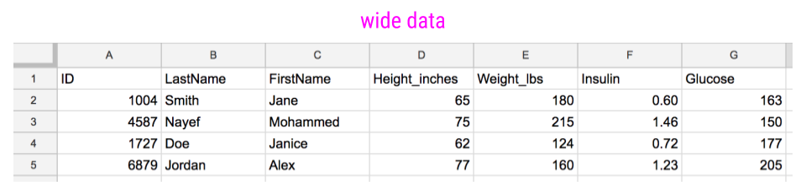
Tidy Data

Slide 23
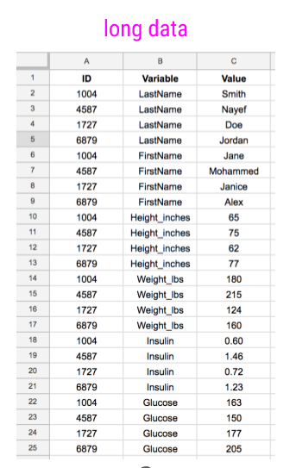
Tidy Data

Slide 24
Tidy Data

Slide 25
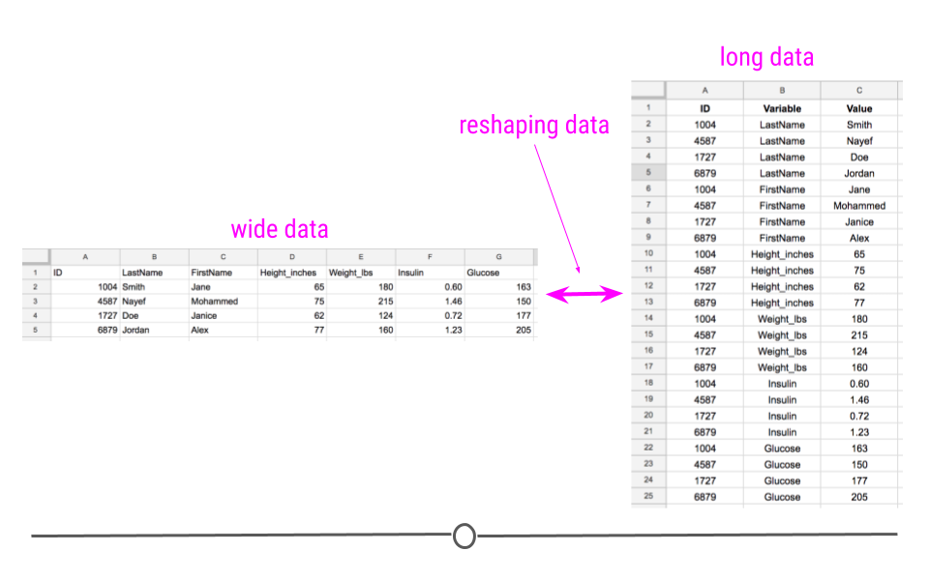
Tidy Data

Slide 26
Data Wrangling
dplyr
• mutate() adds new variables that are functions of existing variables
• select() picks variables based on their names.
• filter() picks cases based on their values.
• summarise() reduces multiple values down to a single summary.
• arrange() changes the ordering of the rows.
• You also need to know group_by() which allows you do any function by group.

Slide 27
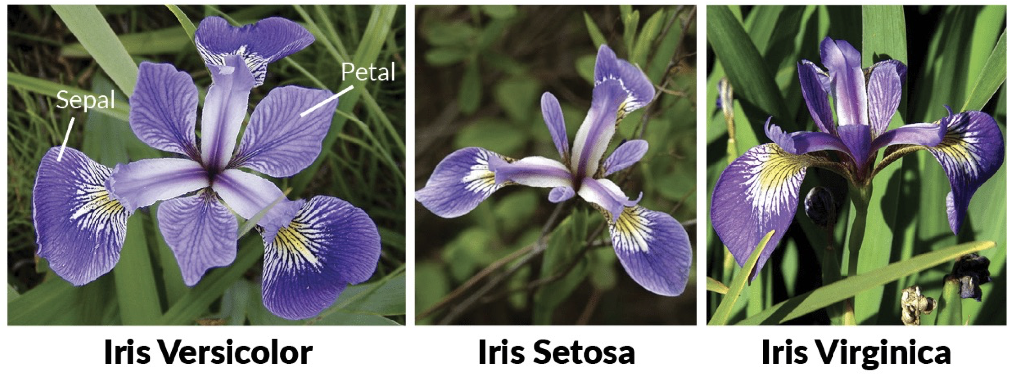
Demo Data

